Slide 1
15.1 - REMOTE USER – AUTHENTICATION PRINCIPLES
This process consists of two steps:
Identification step: Presenting an identifier to the security system. (Identifiers should be assigned carefully, because authenticated identities are the basis for other security services, such as access control service.)
Verification step: Presenting or generating authentication information that corroborates the binding between the entity and the identifier.

Slide 2
For example:
Alice Toklas could have the user identifier ABTOKLAS. This information needs to be stored on any server or computer system that Alice wishes to use and could be known to system administrators and other users.
A typical item of authentication information associated with this user ID is a password, which is kept secret (known only to Alice and to the system).
Alice’s ID is not secret, system users can send her email, but because her password is secret, no one can pretend to be Alice.
Identification is the means by which a user provides a claimed
User authentication is the means of establishing the validity of the claim.

Slide 3
Electronic User Authentication
NIST SP 800-63-2 (Electronic Authentication Guideline, August 2013) defines electronic user authentication as the process of establishing confidence in user identities that are presented electronically to an information system.
Systems can use the authenticated identity to determine if the authenticated individual is authorized to perform particular functions, such as database transactions or access to system resources.

Slide 4
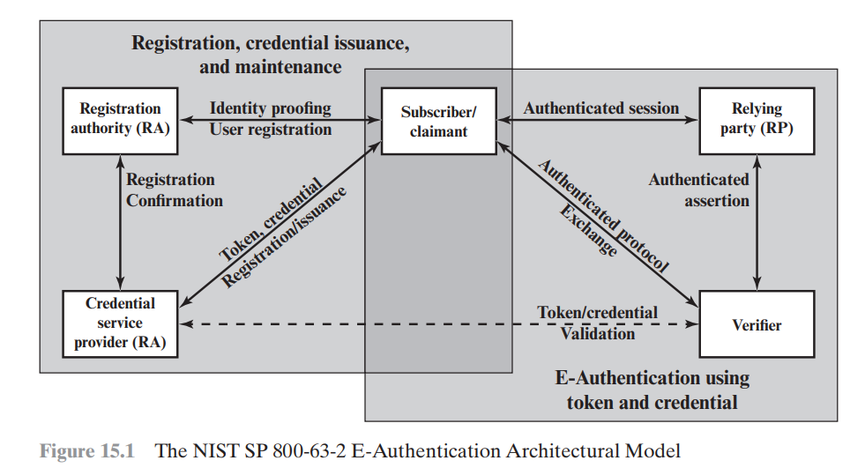
General Model For User Authentication

Slide 5
Registration Process
An applicant applies to a registration authority (RA) to become a subscriber of a credential service provider (CSP).
RA is a trusted entity
RA establishes and vouches for the identity of an applicant to a CSP
CSP engages in an exchange with the subscriber
The CSP issues electronic credential to the subscriber depending on the details of the overall authentication system

Slide 6
Credential
The credential is a data structure that authoritatively binds an identity and additional attributes to a token possessed by a subscriber, and can be verified when presented to the verifier in an authentication transaction.
The token could be an encryption key or an encrypted password that identifies the subscriber.
The token may be issued by the CSP, generated directly by the subscriber, or provided by a third party. The token and credential may be used in subsequent authentication events.

Slide 7
Authorization or Authentication Process
Once a user is registered as a subscriber, the actual authentication process can take place between the subscriber and one or more systems that perform authentication and, subsequently, authorization.
Claimant : The party to be authenticated
Verifier : The party verifying that identity

Slide 8
Authorization or Authentication Process
When a claimant successfully demonstrates possession and control of a token to a verifier through an authentication protocol, the verifier can verify that the claimant is the subscriber named in the corresponding credential.
The verifier passes on an assertion about the identity of the subscriber to the relying party (RP).
Assertion :
identity information about a subscriber(e.g. subscriber name),
an identifier assigned at registration,
or other subscriber attributes that were verified in the registration process.

Slide 9
Means Of Authentication
Something the individual knows: Examples include a password, a personal identification number (PIN), or answers to a prearranged set of questions.
Something the individual possesses: Examples include cryptographic keys, electronic keycards, smart cards, and physical keys. This type of authenticator is referred to as a token.
Something the individual is (static biometrics): Examples include recognition by fingerprint, retina, and face.
Something the individual does (dynamic biometrics): Examples include recognition by voice pattern, handwriting characteristics, and typing rhythm.

Slide 10
Mutual Authentication
Mutual authentication protocols enable communicating parties to satisfy themselves mutually about each other’s identity and to exchange session keys.
Two issues:
confidentiality and
timeliness

Slide 11
Confidentiality
To prevent masquerade and to prevent compromise of session keys, essential identification and session-key information must be communicated in encrypted form.
This requires the prior existence of secret or public keys that can be used for this purpose.

Slide 12
Timeliness
The second issue, timeliness, is important because of the threat of message replays.
Such replays, at worst, could allow an opponent to compromise a session key or successfully impersonate another party.
At minimum, a successful replay can disrupt operations by presenting parties with messages that appear genuine but are not.

Slide 13
Examples of Replay Attacks
The simplest replay attack is one in which the opponent simply copies a message and replays it later.
An opponent can replay a timestamped message within the valid time window. If both the original and the replay arrive within then time window, this incident can be logged.
As with example (2), an opponent can replay a timestamped message within the valid time window, but in addition, the opponent suppresses the original message. Thus, the repetition cannot be detected.
Another attack involves a backward replay without modification. This is a replay back to the message sender. This attack is possible if symmetric encryption is used and the sender cannot easily recognize the difference between messages sent and messages received on the basis of content.

Slide 14
Solution to Replay Attacks
One approach to coping with replay attacks is to attach a sequence number to each message used in an authentication exchange. A new message is accepted only if its sequence number is in the proper order. The difficulty with this approach is that it requires each party to keep track of the last sequence number for each claimant it has dealt with.

Slide 15
Two General Approaches To Counter Replay Attacks
Timestamps: Party A accepts a message as fresh only if the message contains a timestamp that, in A’s judgment, is close enough to A’s knowledge of current time. This approach requires that clocks among the various participants be synchronized.
Challenge/response: Party A, expecting a fresh message from B, first sends B a nonce (challenge) and requires that the subsequent message (response) received from B contain the correct nonce value.

Slide 16
One Way Authentication
One application for which encryption is growing in popularity is electronic mail (email). The very nature of electronic mail, and its chief benefit, is that it is not necessary for the sender and receiver to be online at the same time.
The “envelope” or header of the email message must be in the clear, so that the message can be handled by the store-and-forward email protocol, such as the Simple Mail Transfer Protocol (SMTP) or X.400.
However, it is often desirable that the mail-handling protocol not require access to the plaintext form of the message.

Slide 17


Slide 18



17.1 - WEB SECURITY CONSIDERATIONS
Web servers easy to configure and manage
Web browsers easy to use
Web content easy to develop
But underlying software is extraordinarily complex and may hide many potential security flaws

Slide 19
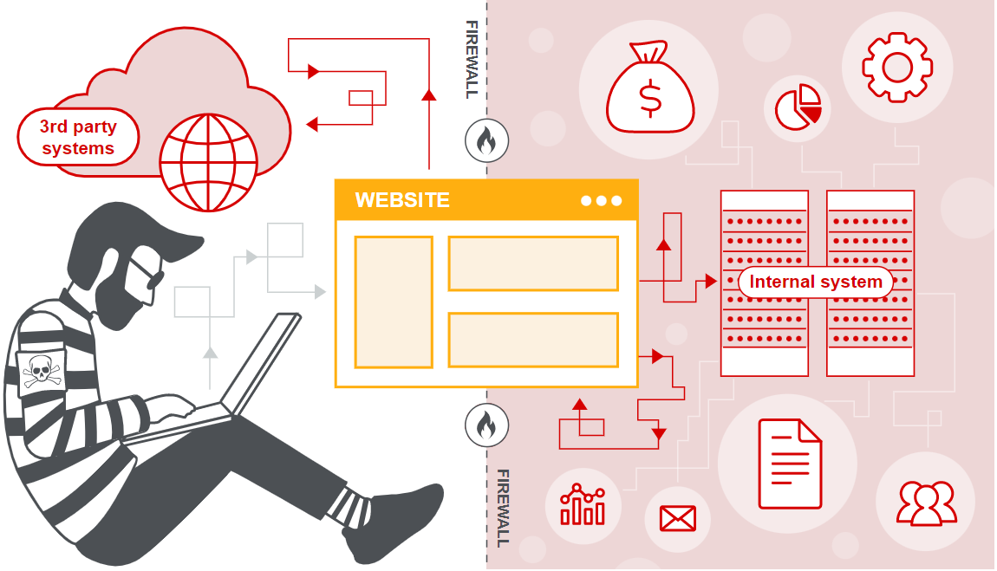
A Web server can be exploited as a launching pad into the corporation’s or agency’s entire computer complex. Once the Web server is subverted, an attacker may be able to gain access to data and systems not part of the Web itself but connected to the server at the local site.

Slide 20
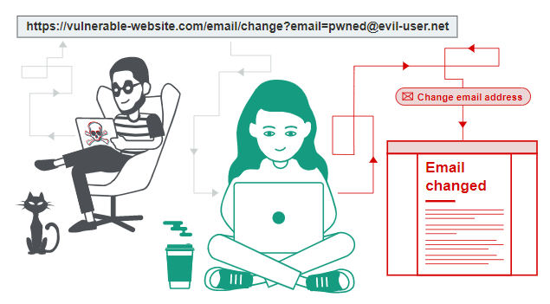


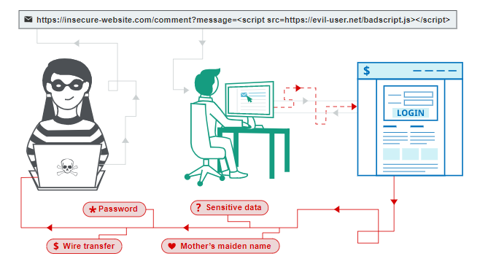

Casual and untrained (in security matters) users are common clients for Webbased services. Such users are not necessarily aware of the security risks that exist and do not have the tools or knowledge to take effective countermeasures.

Slide 21
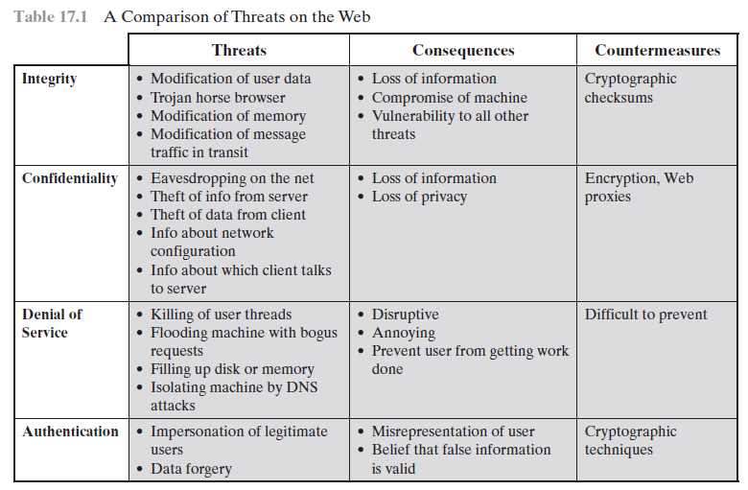
Web Security Threats

Slide 22
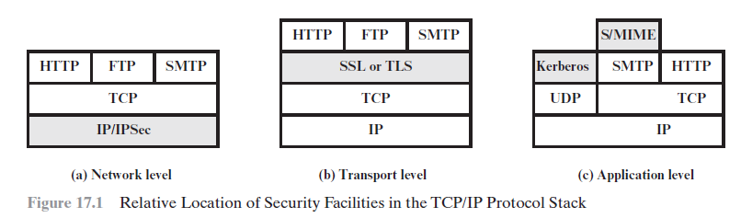
Web Traffic Security Approaches
The various approaches that have been considered are similar in the services they provide and, to some extent, in the mechanisms that they use, but they differ with respect to their scope of applicability and their relative location within the TCP/IP protocol stack.

Slide 23
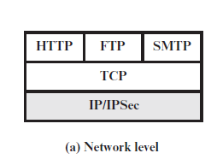
Network level - IP security (IPsec)
One way to provide Web security is to use IP security (IPsec) (Figure 17.1a). The advantage of using IPsec is that it is transparent to end users and applications and provides a general-purpose solution.
Furthermore, IPsec includes a filtering capability so that only selected traffic need incur the overhead of IPsec processing.

Slide 24
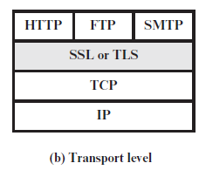
Transport level - Secure Sockets Layer (SSL) and Transport Layer Security (TLS)
Another relatively general-purpose solution is to implement security just above TCP (Figure 17.1b).
At this level, there are two implementation choices.
For full generality, Secure Sockets Layer (SSL) (or Transport Layer Security (TLS)) could be provided as part of the underlying protocol suite and therefore be transparent to applications.
Alternatively, TLS can be embedded in specific packages. For example, virtually all browsers come equipped with TLS, and most Web servers have implemented the protocol.

Slide 25
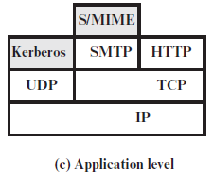
Application level
Application-specific security services are embedded within the particular application.
Figure 17.1c shows examples of this architecture.
The advantage of this approach is that the service can be tailored to the specific needs of a given application.

